Slide 1
Intro to D3.js
Data Viz. & Analytics
October 1, 2016

Slide 2

Full Confession…
I am definitely no “expert” on D3.js.
This talk is meant to be a primer to help speed up your D3 initiation.

Slide 3
Full Confession…
Because D3.js is hard.

Slide 4
Data Visualization

Slide 5
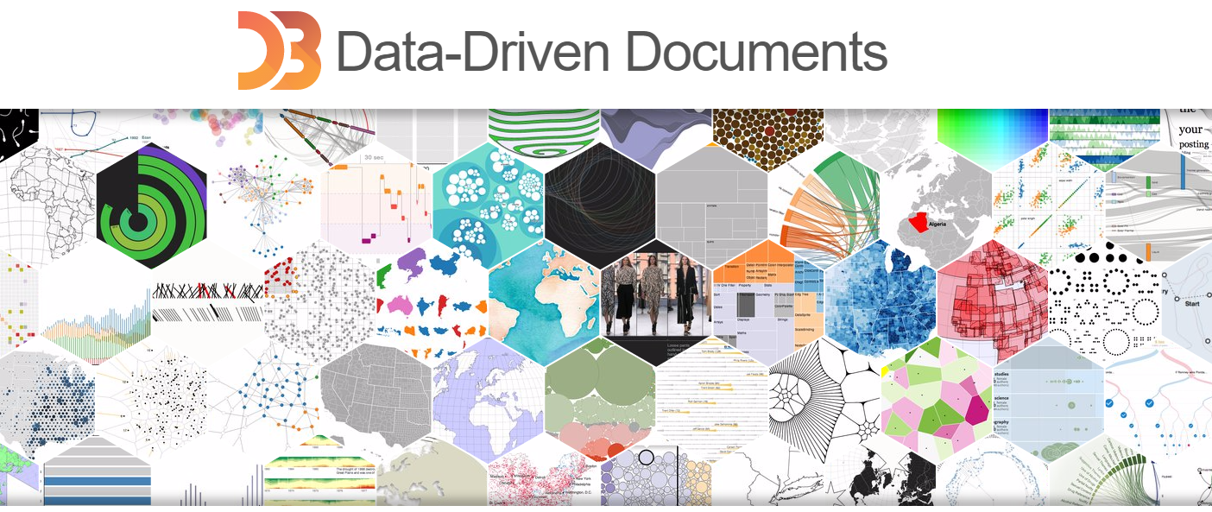
What is D3.js?
“It’s for data visualization right?”

Slide 6
The Bigger Question
Yes (sort of.) …
But what exactly is “data visualization”?

Slide 7

The “Story” of Data
Data Visualization is about taking data and telling a story.
It’s a general term to describe any effort to better understand the significance of data by placing it in a visual context.
It pulls out patterns, trends, and correlations that would otherwise go unnoticed in text or tables – and presents it in ways that are immediately clear.

Slide 8
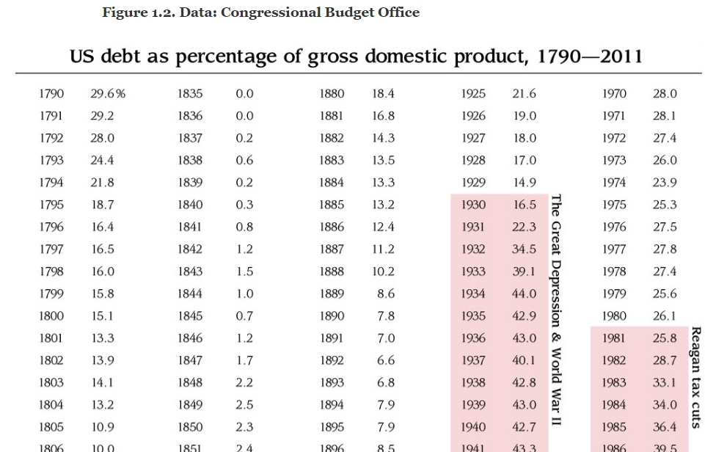
The “Story” of Data

Slide 9
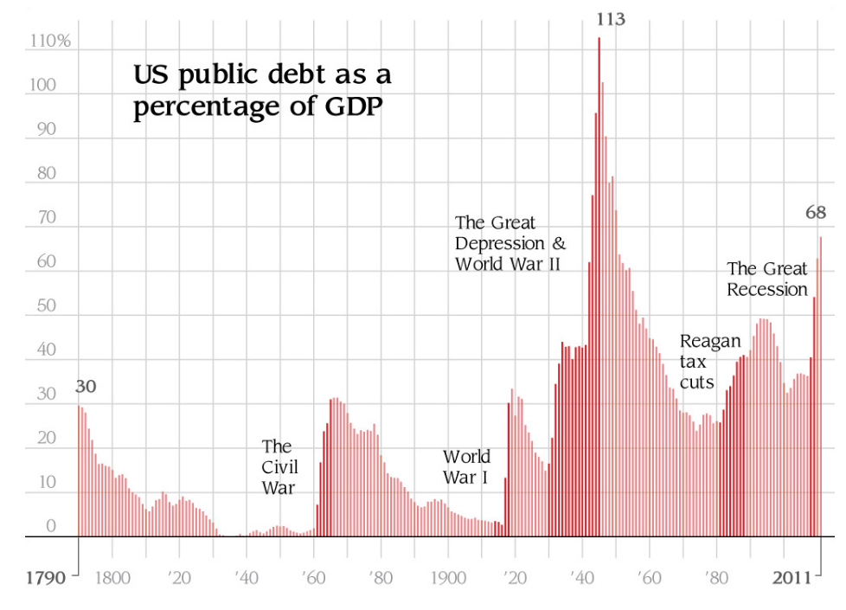
The “Story” of Data

Slide 10
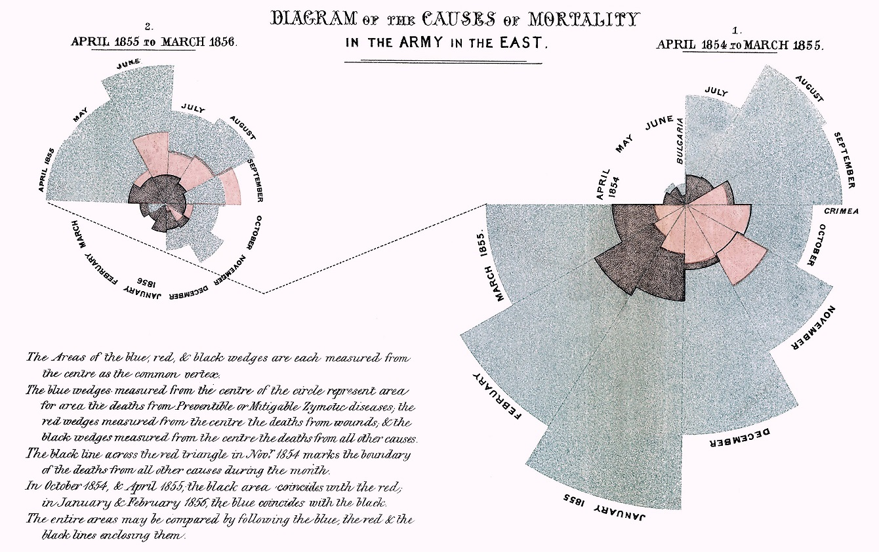
History of Data Visualization

Slide 11
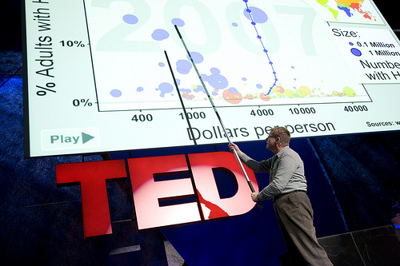
History of Data Visualization
https://www.ted.com/talks/hans_rosling_shows_the_best_stats_you_ve_ever_seen?language=en

Slide 12
Basics of D3.js

Slide 13
What is D3.js? (Round II)
“So. It’s for graphs right?”

Slide 14
What is D3.js?
Sort of... But not really.

Slide 15
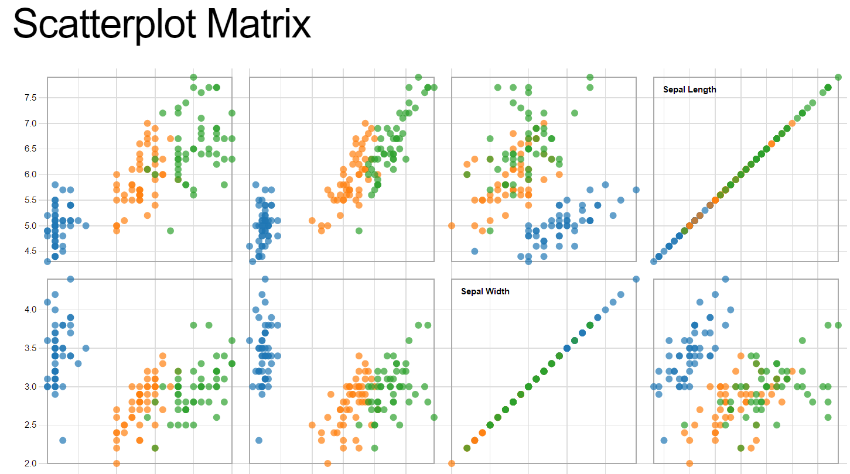
D3.js in Examples
http://bl.ocks.org/mbostock/3213173

Slide 16
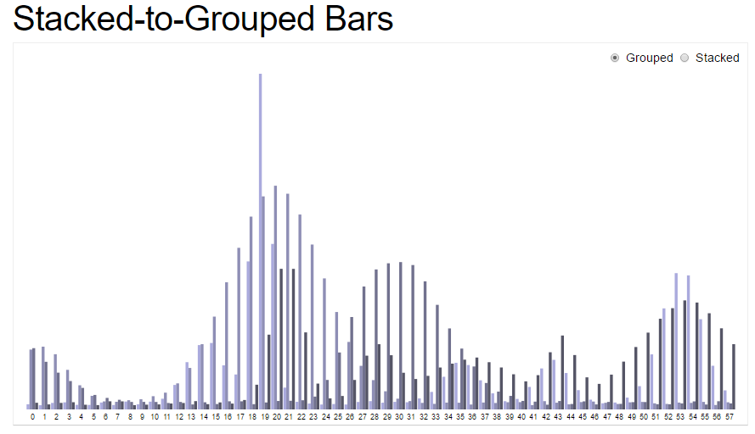
D3.js in Examples
http://bl.ocks.org/mbostock/3943967

Slide 17
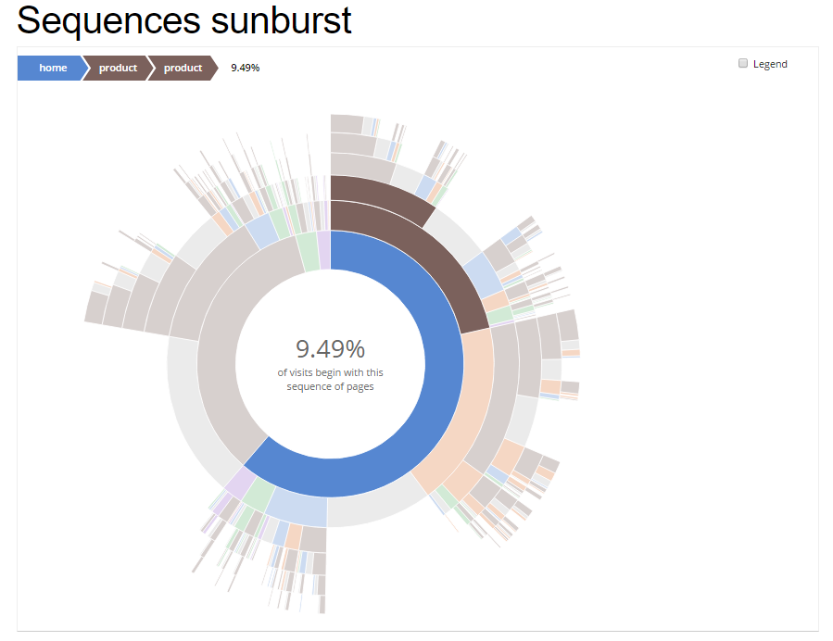
D3.js in Examples
http://bl.ocks.org/kerryrodden/7090426

Slide 18
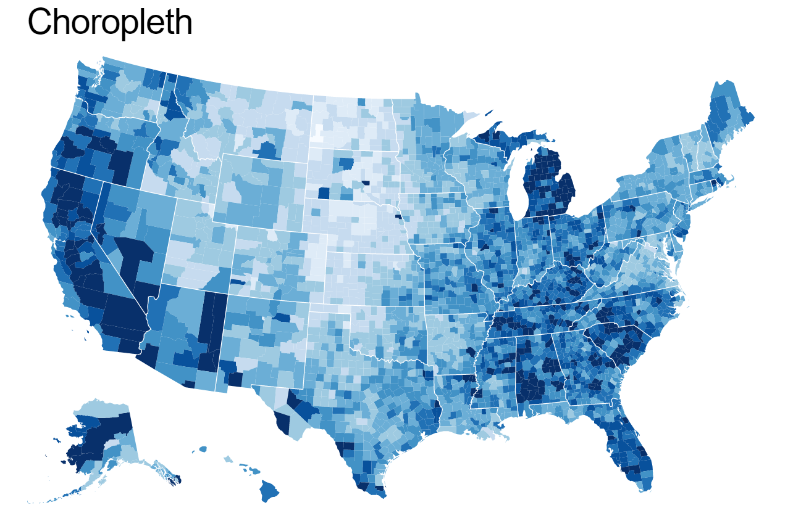
D3.js in Examples
http://bl.ocks.org/mbostock/4060606

Slide 19
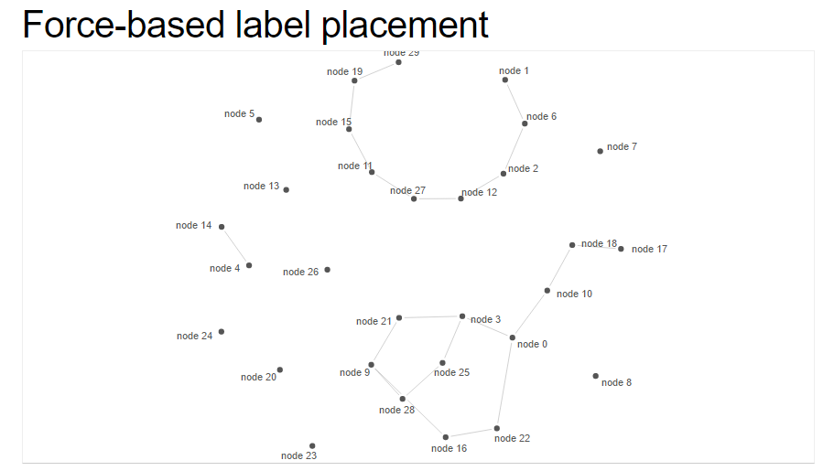
D3.js in Examples
http://bl.ocks.org/MoritzStefaner/1377729

Slide 20
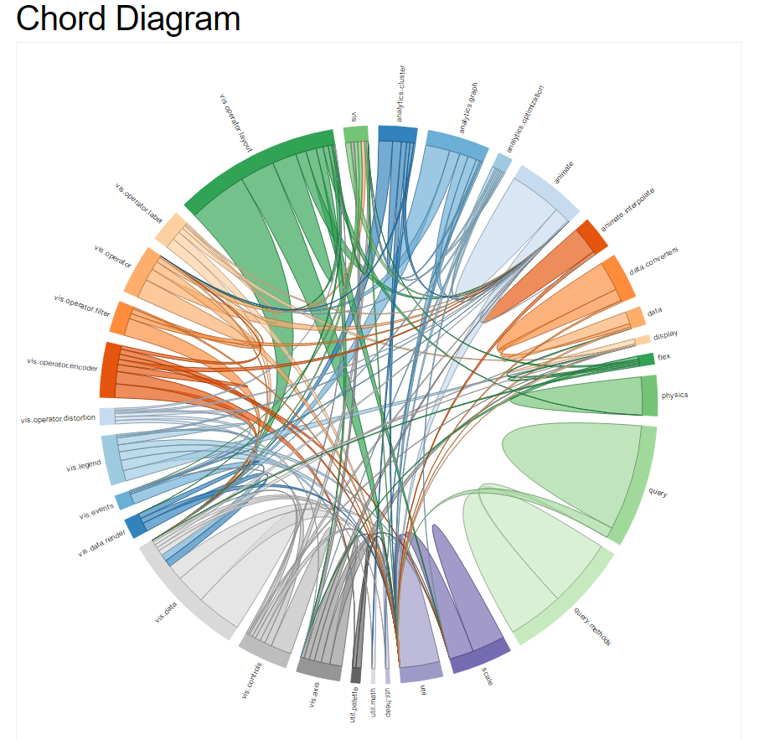
D3.js in Examples
http://bl.ocks.org/mbostock/1046712

Slide 21
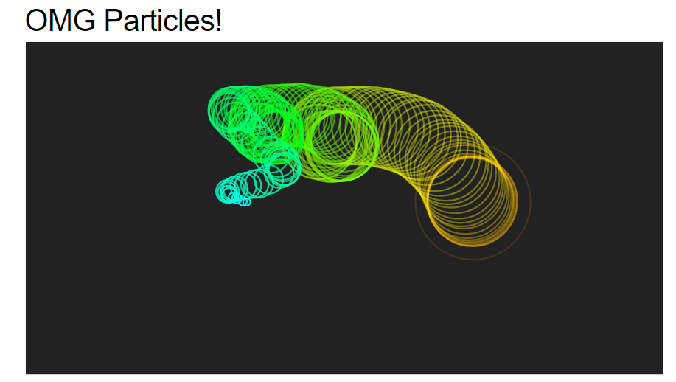
D3.js in Examples
http://bl.ocks.org/mbostock/1062544

Slide 22
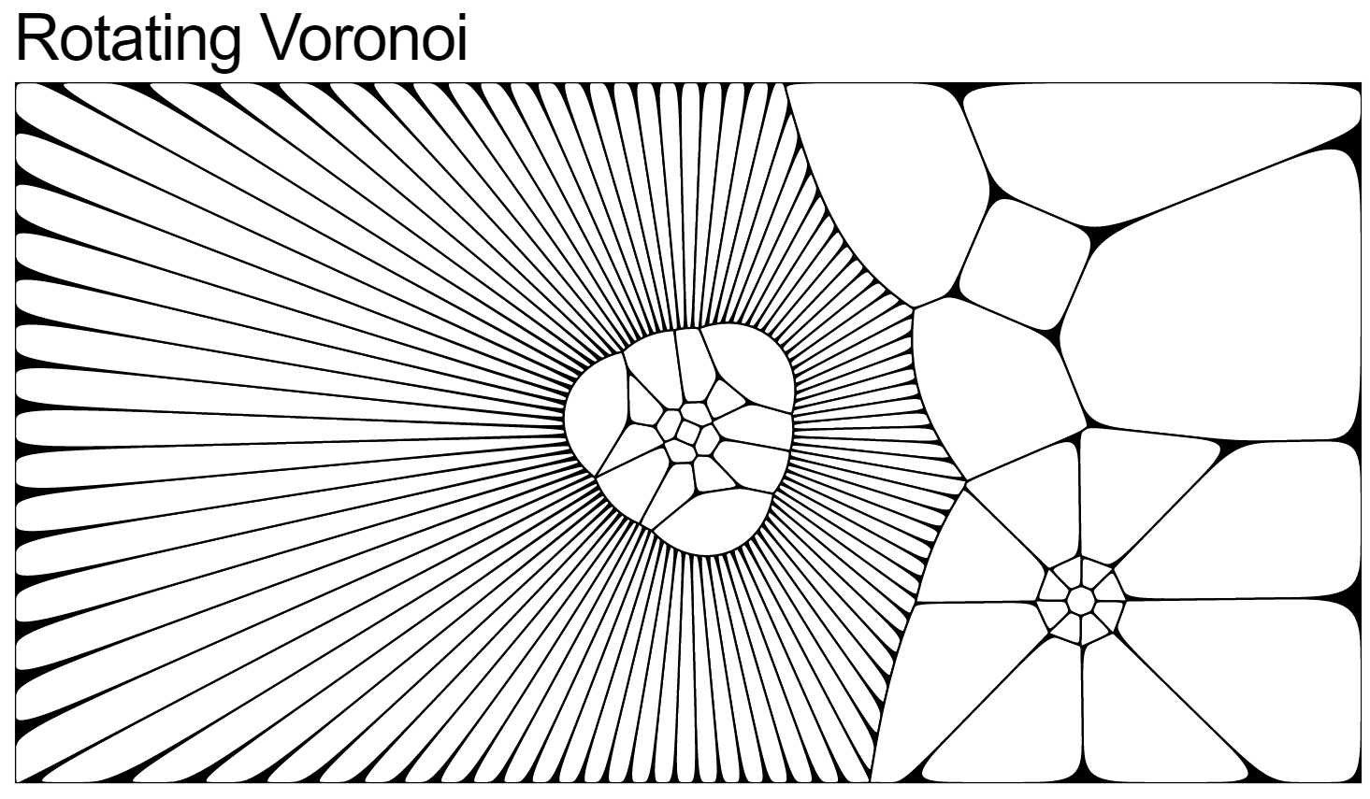
D3.js in Examples
http://bl.ocks.org/mbostock/4636377

Slide 23
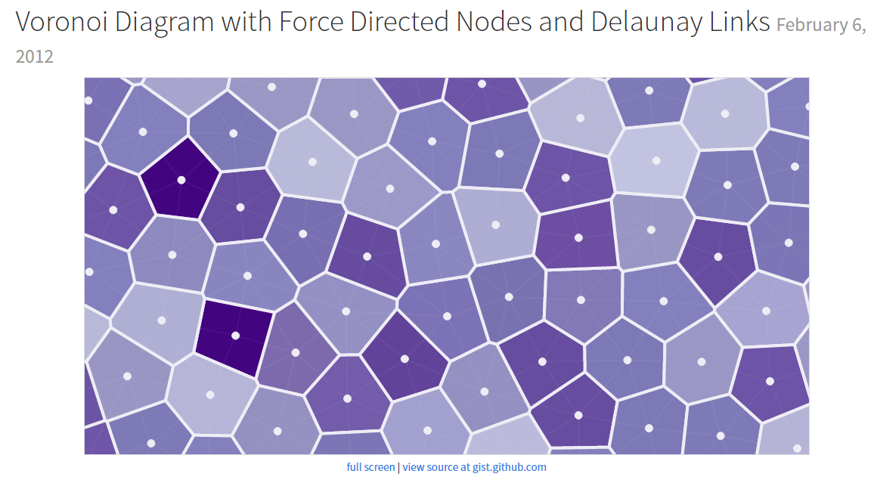
D3.js in Examples
http://bl.ocks.org/mbostock/4636377

Slide 24
What is D3.js? (Finally)
D3.js is an open source Javascript library that facilitates HTML manipulation based upon data.
D3 stands for (Data Driven Documents) and is popularly known as a data visualization library.
Its key claim to fame is that it provides very granular:
Selection of HTML DOM Elements
An ability to bind data directly to these HTML elements
Ability to control transition between these elements based upon dynamic changes to data.
Manipulation of HTML, CSS, and SVG based on data

Slide 25
What is D3.js? (Finally)
Basically… it’s for a lot of things.
But in short: It’s about binding data to HTML. It provides tools to manipulate the HTML in creative ways accordingly.

Slide 26
What is D3.js? (Finally)
Basically… it’s for a lot of things.
But in short: It’s about binding data to HTML. It provides tools to manipulate the HTML in creative ways accordingly.
Data:
[2, 12, 4…]
DOM:
HTML Element #1
HTML Element #2
HTML Element #3

Slide 27

What is D3.js… not?
D3.js is not a “plug and play” graph builder.
D3.js is not your best option for simple visualizations (Though it could work).
D3 is not a friendly solution for a business to run analytics on.
Not a D3 pro…

Slide 28
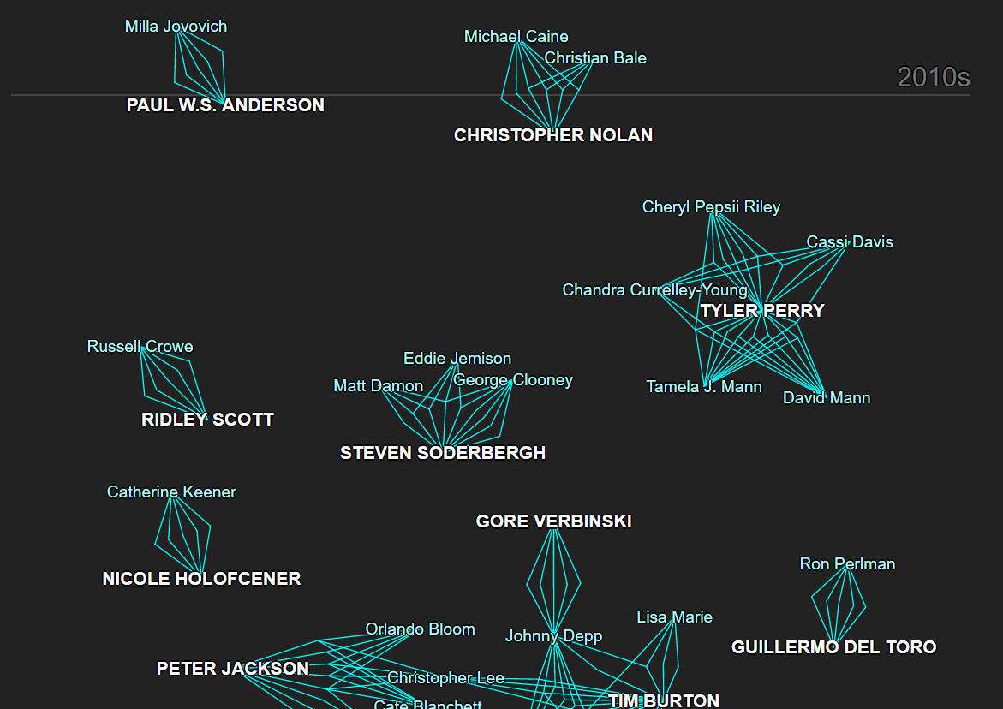
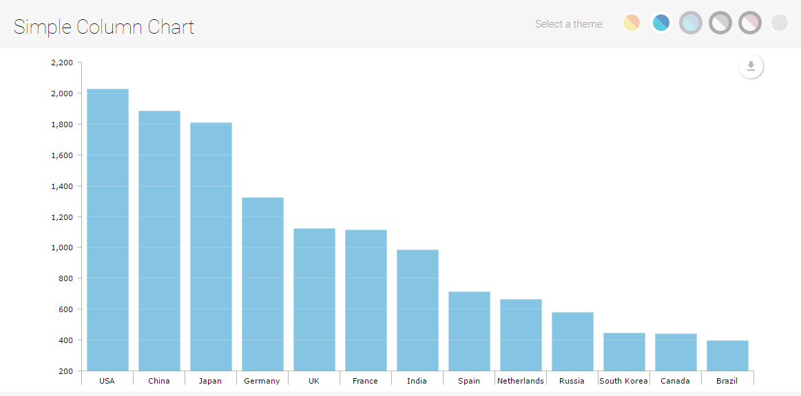
Why Not Just Use… a charting library?
D3.js Library
AMCharts Library
D3.js allows you to build fully customized data visualizations with limitless possibility.

Slide 29
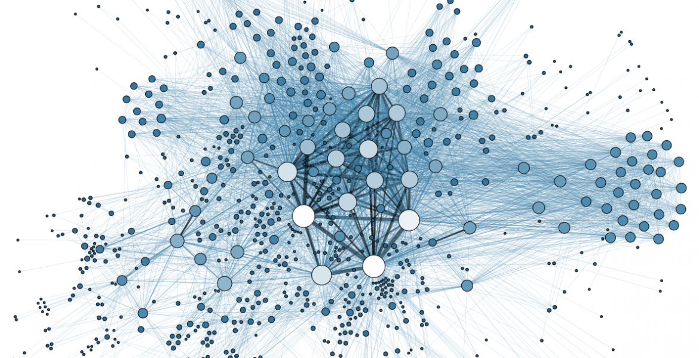
Why Not Just Use… jQuery?
D3.js has a ton more tools for extracting and binding data directly to the DOM than jQuery.

Slide 30
Code Mechanics

Slide 31
TIME TO CODE
Before we dig into the mechanics, let’s experiment with some code.

Slide 32
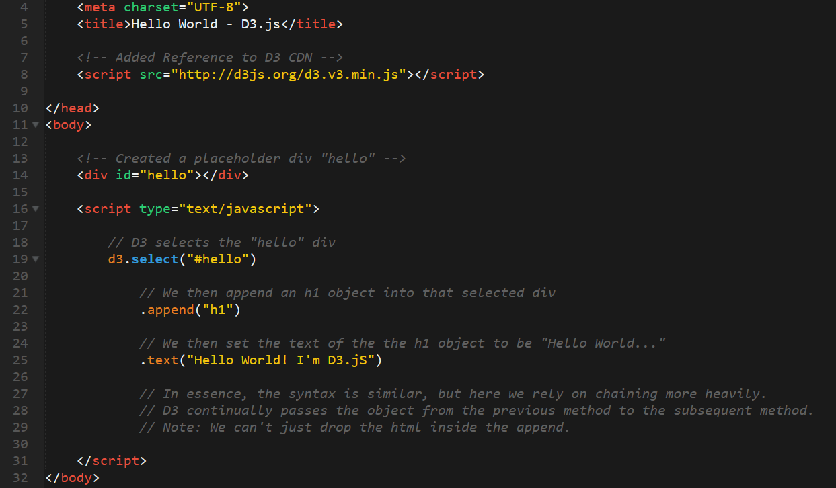
Hello World – D3.js

Slide 33
Selecting and Chaining
HTML Element (#hello)
D3.select(#hello)
Grabs and returns the
HTML Element
.append(h1)
Grabs the HTML Element
but returns the new h1
.text(“Hello World”)
Sets the text value of the new h1 element.

Slide 34
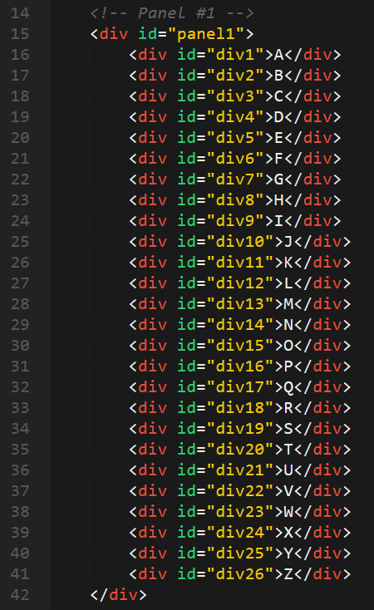
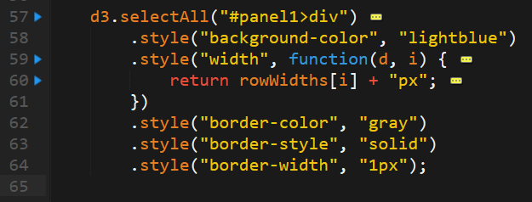
Data Binding… Say What?
HTML Elements
D3 Code

Slide 35
Selecting and Mapping
HTML Elements
D3 Code
Div
Div
Div
D3.selectAll(…)
Map of all divs
Div
Div

Slide 36
TIME TO CODE
Let’s bring in the “data”!

Slide 37
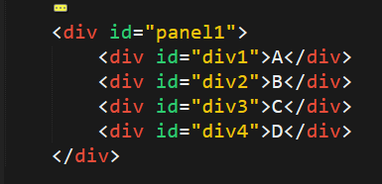
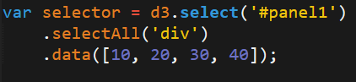
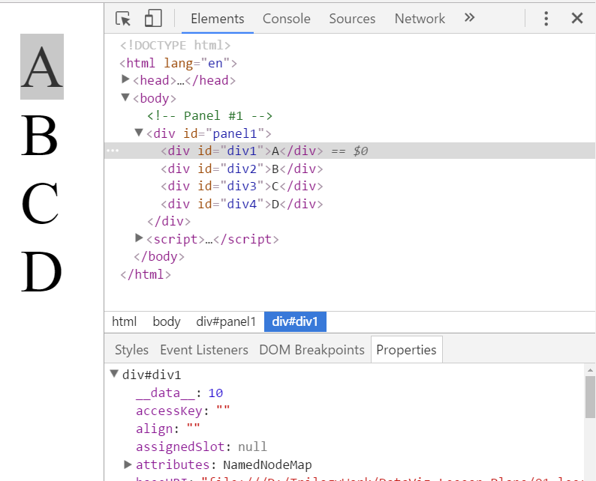
Data Binding Say What?
HTML Elements
D3 Code
Inspector
D3 associates each div with a “data” property.
(Note: This is not the same as data attribute).

Slide 38
Data Binding Say What?
ID
Data Property
VALUE
When using D3 – recognize that every HTML element can be bound to a data property. Thus HTML elements will be composed of a data property, value, and ID.

Slide 39
Data Binding Say What?
div1
10
div2
20
10
40
div3
30
div4
40
60
These values do not necessarily need to match. In essence the “data property” is what’s backed up by the data – but for the text (or visual) you are free to use the data however you like. In fact, elements can even have a data property but no value.

Slide 40
Enter, Update, Exit
Enter, Update, Exit handling is one of the most important data binding concepts in D3.
In essence, these terms describe how D3 handles the syncing of what’s in the “data” with what’s displayed on the page
Each time new data comes in, is updated or removed there needs to be subsequent code to handle the change to the view.

Slide 41
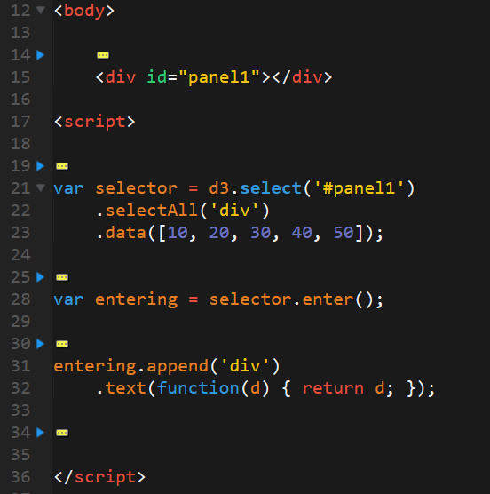
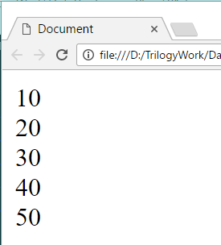
Enter!
In this case D3 created div elements to match the existing data.
.enter() allows us to create data driven events upon new data emerging.

Slide 42
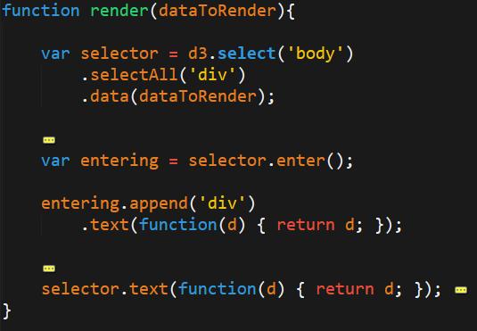
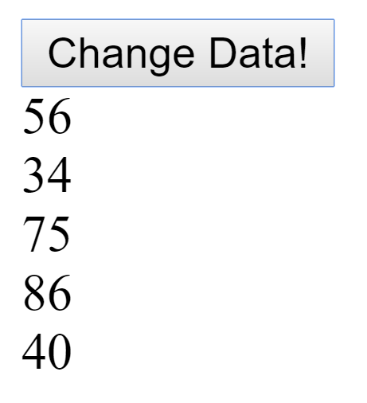
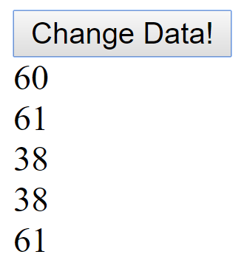
Update!
In this case D3 handled events in which our data updated. In this case, it means having code to handle the text change as well.
No special event is needed here, we just need to tell the selector to change the text.

Slide 43
Update!
Initial Data
[10, 20, 30]
Before change of data
div1
10
div2
10
div3
10
10
20
30
New Data
[100, 200, 300]
div1
100
div2
100
div3
100
After change of data
100
200
300

Slide 44
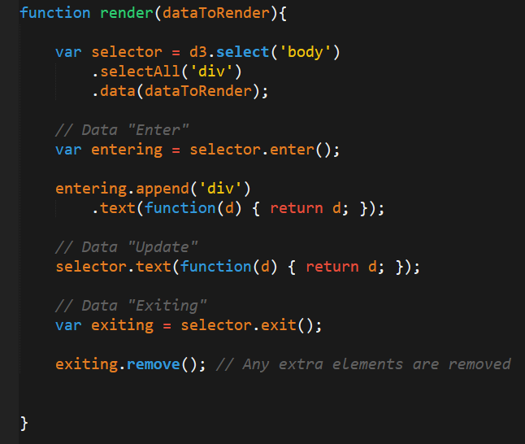
Exit!
In this case, D3 handles the removal of divs to match the reduction in data elements.
Here we rely on the .exit() method to capture the data driven event.

Slide 45
Exit!
Initial Data
[10, 20, 30]
Before change of data
div1
10
div2
10
div3
10
10
20
30
New Data
[10, 20]
div1
1
div2
100
div3
After change of data
10
20

Slide 46
DEMO TIME
Time to work on something fun / painful.
(Don’t get any crazy ideas. It’s still just code)

Slide 47
SVG

Slide 48



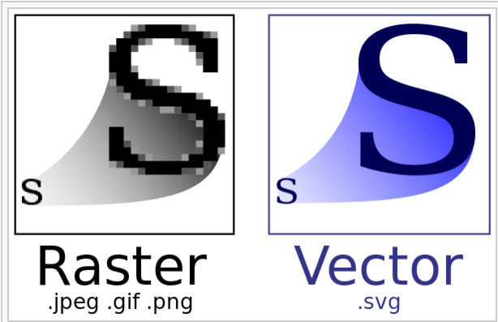
Look Ma! No Blur.
SVG, or Scalable Vector Format, is an image format based on vector graphics.
Because SVGs are a non-raster format there are no pixels to distort.
This makes SVGs perfect for animations and interactivity.
In D3, we can make use of SVGs as the base elements of our visualizations.

Slide 49

SVG Shapes and Transformations
In HTML we can easily create an assortment of SVG shapes and paths for use in building more complex visuals.
Shape examples:
Circles
Ellipses
Rectangles
Squares
Lines
Stars
And more!
We can further use SVG transformations to change how our shapes look in response to other events (hint: in our case: data)

Slide 50
Build a Graph!

Slide 51

Closing Thoughts
At this point you should:
Stick around a while and build something!
Throw D3.js on your resume. (You know enough)
Keep exploring! There’s plenty more to do.

Slide 52
Questions

Slide 53

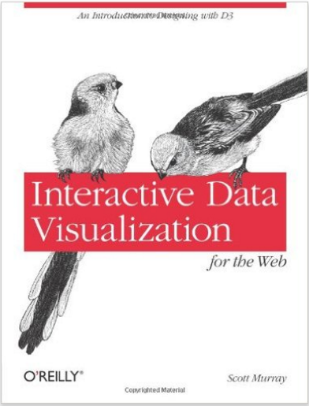
Recommended Reading

